Slide 1


U n I v e r s I t y ADMISSION FORM
PROGRAMMING FUNDAMENTALS LAB
Lite code program
Hammad Ali (Team Leader) 022
Group No: 4
PRESENTED BY:

Slide 2
DESCRIPTION & ADVANTAGES
This is a University Admission Form in Which Help to Organization to management Data. Data Save in Computer Database. No Need to Save Data in Hard Form
Users Select Course
Users Enter Data (Like Personal Details, Qualification) To Admission Form. Auto Generated fee Callan form.
If Users Pay Online Fee then after generated
Fee Callan Give Option

Slide 3

OBJECTS WE USE
Loops
If-Else
Operators
Switch Statement
Local and Global Variables
Functions

Slide 4
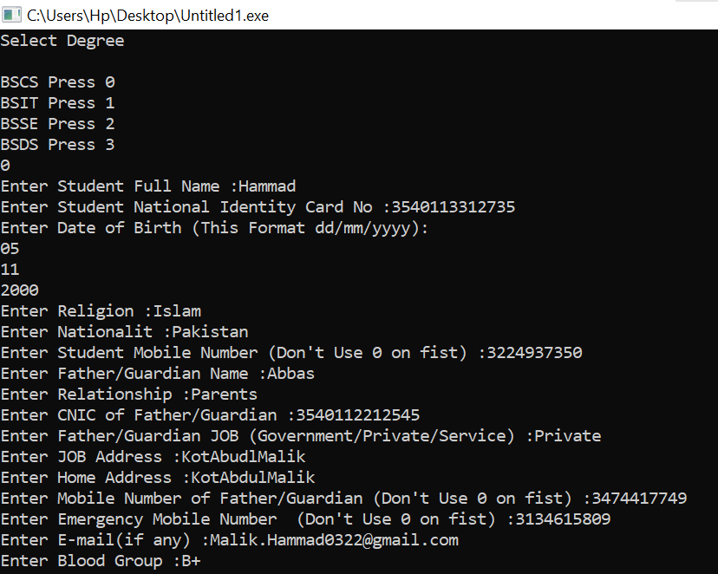
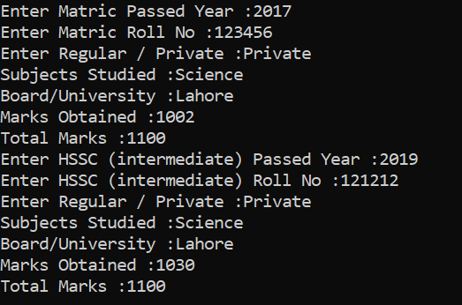
INPUTS

Slide 5
OUTPUT

Slide 6
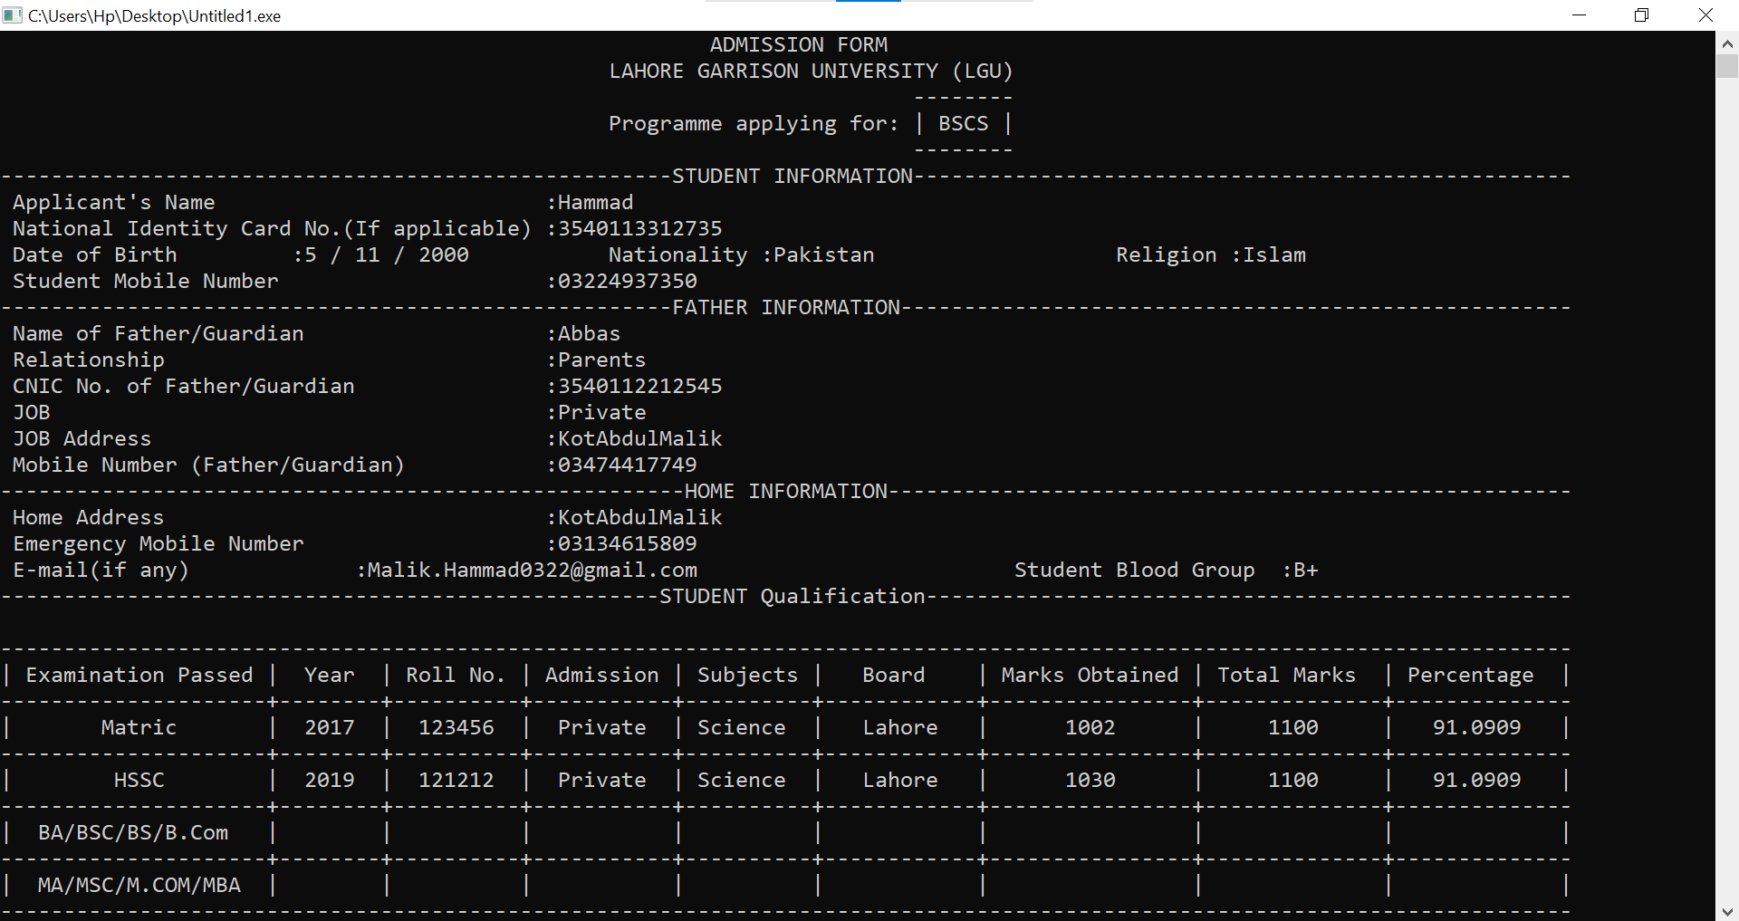
STUDENT DETAILS

Slide 7
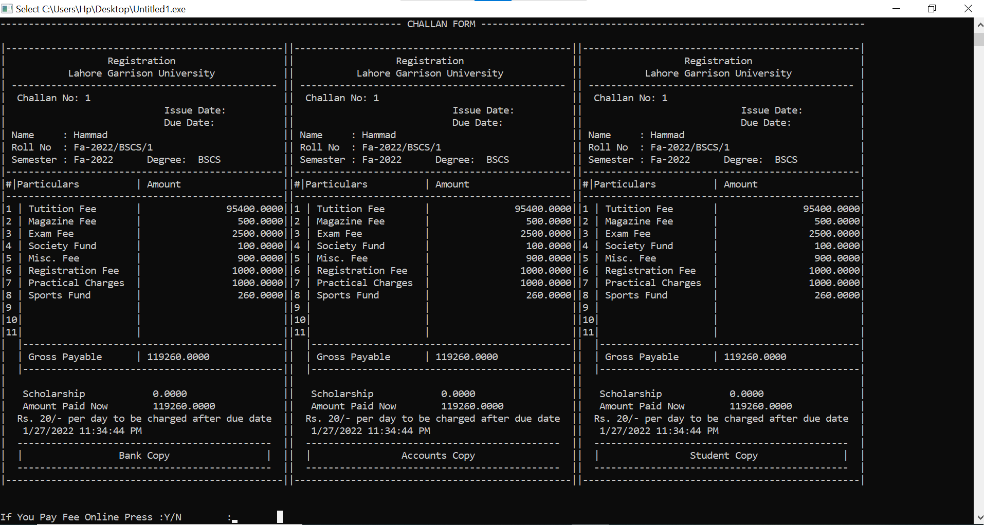
CHALLAN FORM

Slide 8
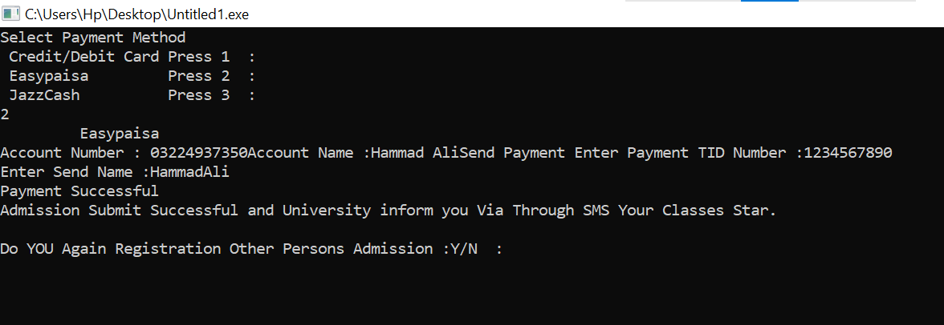
ONLINE FEE PAY

Slide 9
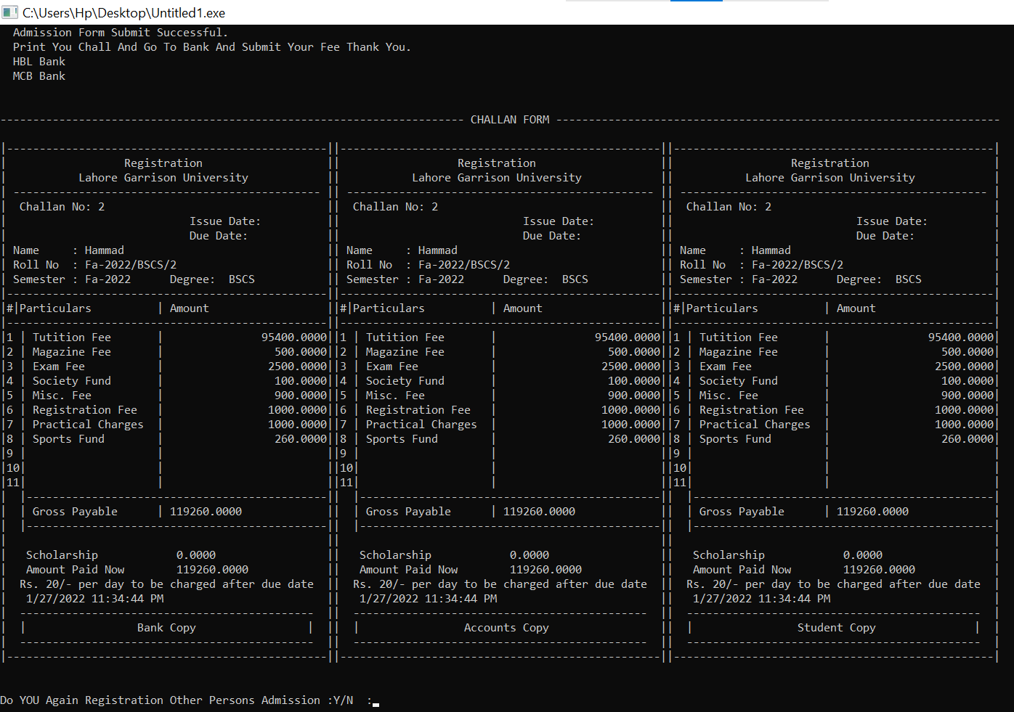
CHALLAN For Bank

